Slide 1

UCB Data Analytics Bootcamp Spring 2020 Clinical trials analysis
Team Pyed Pyper
Nick Nasse, Parker Prowell, Raymond Garskovas, Varun Kaushik

Slide 2
Agenda
Scope and hypothesis
Methodology
Analysis
Conclusion
Post-mortem

Slide 3
Scope and hypothesis
Our initial project outline was to uncover patterns in clinical trials related to the COVID-19 pandemic across the globe through four main analyses:
# | Analysis description | Desired result | Initial hypothesis
1 | Measuring the growth of types of trials over time | An understanding of the growth rate of trials YoY for Covid-19 | A significant acceleration of trials being conducted in early to mid 2020
2 | Measuring the number of locations conducting clinical trials | Insight into the total number of locations conducting trials as well as the amount of locations a given trial is using | A large number of locations per trial
3 | Examining relationships between types of trials and location (state / country) | A comprehensive view of countries conducting trials and how they compare to the rest of the world | Developed nations will have the most trials in progress
4 | Demographic (age / gender) comparisons across trials | A complete understanding of which demographics are most present in on-going clinical trials | A higher presence of elderly (65+ year old) adults in trials
Overarching hypothesis: trials related to Covid-19 have grown significantly and are conducted in many locations primarily in developed nations with primary focus on the study of elderly patients

Slide 4
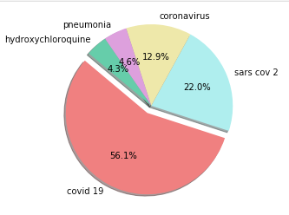
Methodology and data collection
Data source -
Due to a 1997 regulation, the National Institute of Health is required to make clinical trial data public
In the year 2000 the ClinicalTrials.gov site was launched and an API was launched in 2011
Using the API -
Made several queries from the database using “keyword” field to drive filtering of data
The keywords we selected were:
“COVID-19”
“SARS-Cov-2”
“Coronavirus”
“Covid-19”
“ARDS”
Next step –
Once we had collected the data, we needed to consolidate and clean the data
Reduction by keywords:
2,874
Total trials in database:
346,890
RG comment: may need to adjust the keywords section

Slide 5
Data analysis and clean-up process
Work in progress
Using ClinicalTrials.gov’s API we queried data
In an effort to limit the scope of the project we used the following methods:
Reducing by keywords:
“COVID-19”
“SARS-Cov-2”
“Coronavirus”
“Covid-19”
“ARDS”
Searching for trials

Slide 6
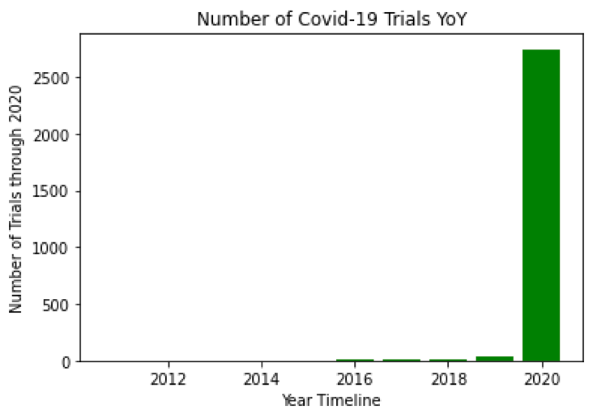
Analysis 1: The number of new clinical trials (YoY growth by sponsor type)
Initial hypothesis: the number of Covid Trials have accelerated rapidly in 2019
and into the first half of 2020
TBD
Based on our observations we have found that our hypothesis has been XYZ due to the following reasons:
Exhibit X shows the
AT
Conclusion: despite the first trial taking place well before, the number of Covid Trials have accelerated rapidly in 2019 and into the first half of 2020

Slide 7
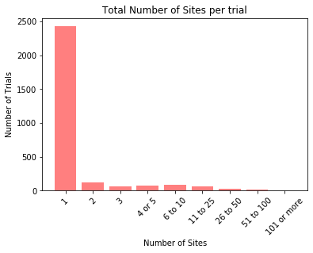
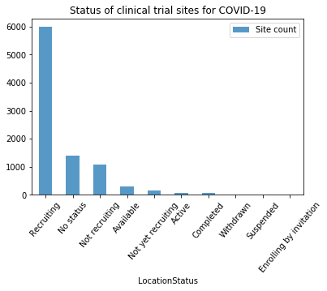
Analysis 2: The average number of locations per trial and the status of trial sites
Initial hypothesis: there are many locations per trial due to the collaboration across the healthcare world
83% of COVID trials are taking place at one location, with a long tail of several outliers
The majority (66%) of the 9,087 total locations hosting a trial are still recruiting
Conclusion: Despite the spread of coronavirus and united effort to find a vaccine across the healthcare ecosystem, trials are mostly taking place at an individual site. These sites are still primarily in the “recruitment” phase, not yet reaching full enrollment

Slide 8
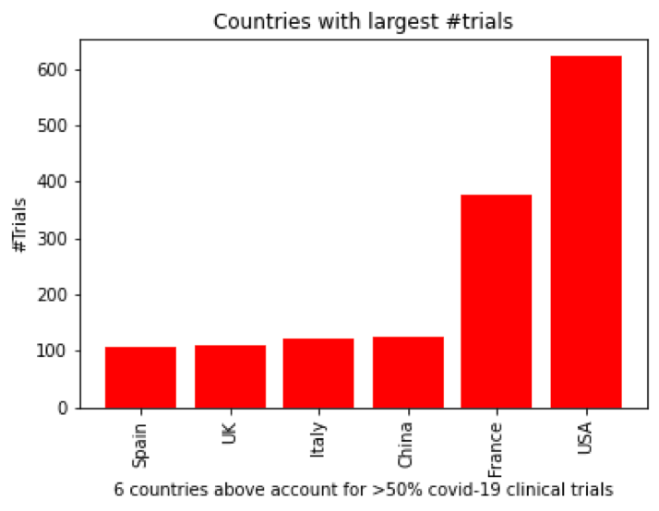
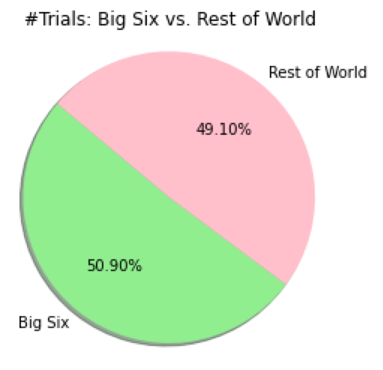
Analysis 3: Trials by Country
Initial hypothesis: the richest countries, which maintain the most sophisticated healthcare systems, will have the highest number of trials in progress
RG Comment - Do we have any data to support that these countries are among the most impacted?
https://www.worldometers.info/coronavirus/
France is #19, China is #27 for instance
We observed a total 186 unique countries running trials with a majority (>50%) of trials taking place within six countries which we labeled as the “big six”.
Conclusion: the number of trials may depend on country wealth, but also may be dependent on the severity of the virus outbreak in a given country. The “big six” are also among the most impacted (and just happen to be able to fund trials)

Slide 9
Analysis 4: Demographic analysis for certain age groups, sex
Initial hypothesis: ages of individuals in trials tend to be more elderly as that demographic is affected at a higher rate than younger demographic
TBD
Based on our observations we have found that our hypothesis has been XYZ due to the following reasons:
Exhibit X shows the
AT
Conclusion: the number of Covid Trials have accelerated rapidly in 2019
and into the first half of 2020

Slide 10


Conclusion
# | Analysis description | Desired result | Initial hypothesis | Observed result
1 | Measuring the growth of types of trials over time | An understanding of the growth rate of trials YoY for Covid-19 | A significant acceleration of trials being conducted in early to mid 2020 | Hypothesis validated
2 | Measuring the number of locations conducting clinical trials | Insight into the total number of locations conducting trials as well as the amount of locations a given trial is using | A large number of locations per trial | Hypothesis not validated
3 | Examining relationships between types of trials and location (state / country) | A comprehensive view of countries conducting trials and how they compare to the rest of the world | Developed nations will have the most trials in progress | Hypothesis validated
4 | Demographic (age / gender) comparisons across trials | A complete understanding of which demographics are most present in on-going clinical trials | A higher presence of elderly (65+ year old) adults in trials
TBD – observed results
Result is that overarching hypothesis of trials related to Covid-19 have grown significantly and are conducted in many locations primarily in developed nations with primary focus on the study of elderly patients is partially confirmed

Slide 11
Post-mortem
Difficulties that arose/ how we dealt with them:
Difficulty surrounding finding metrics for success because trials are on-going. Focused efforts on trial methodology and motivating factors rather than results, at this stage
Not being able to accurately separate columns of data. Due to the formatting of clinical trial data which is comma delimited, some names of organizations also included commas which made consistently separating those values not possible. We dealt with this by using different datapoints
Any additional questions we would like to explore:
How will mutations of Covid-19 impact future trials in terms of demographics? Enrollment numbers? Trial sponsors? Locations?
Understanding how trials in general faired in the time of Covid-19. Presumably, the growth of Covid-19 trials and strain to the healthcare system have reduced the volume of other trials
Tracking the long term success of Covid-19 trials as well as if there are attributes consistent with successful vs unsuccessful trials

